Slide 1
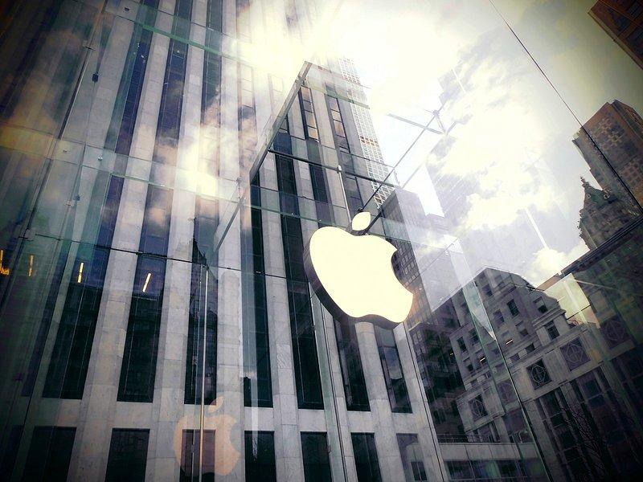
Case Study on Apple – SWOT & Porter’s 5 Forces
February,2025
Abinaya

Slide 2

Apple Inc.: A Brief Introduction
Founded: 1976 by Steve Jobs, Steve Wozniak, and Ronald Wayne Headquarters: Cupertino, California, USA Market Position: One of the world’s leading technology companies, known for innovation and premium products.
Key Products:
iPhone: Market leader in smartphones
Mac: Premium computers and laptops
iPad: Dominant in the tablet market
Apple Watch: Leading in smartwatches
AirPods: Popular wireless earbuds
Services (iCloud, Apple Music, App Store, etc.): Fast-growing revenue stream

Slide 3
Why Analyze Apple?
Apple is an interesting case study due to its strong brand loyalty, innovation-driven growth, and global influence. Its unique ecosystem, pricing strategy, and ability to adapt to market changes make it a valuable company to analyze using SWOT, Porter's 5 Forces, and other business frameworks.

Slide 4

SWOT Analysis – Strengths
Strong brand reputation
Loyal customer base
High-profit margins

Slide 5
SWOT Analysis – Weaknesses
High product pricing
Dependence on hardware sales
Legal issues

Slide 6
SWOT Analysis – Opportunities
Expansion into AI and AR/VR
Increasing services revenue (Apple Music, iCloud)

Slide 7
SWOT Analysis – Threats
Regulatory challenges
Supply chain disruptions
Competition from Samsung and Google

Slide 8
Apple: Porter's 5 Forces - Industry Rivalry
Strong Competition from Samsung, Microsoft, and Google
High Innovation Pressure
Brand Loyalty vs. Price Wars

Slide 9
Apple: Porter's 5 Forces - Supplier Power
• High Dependence on Suppliers (TSMC, Foxconn)

Slide 10
Apple: Porter's 5 Forces - Buyer Power
Strong Brand Loyalty but Price Sensitivity

Slide 11
Apple: Porter's 5 Forces - Threat of New Entrants
•- High Barriers to Entry due to Patents & Branding

Slide 12
Apple: Porter's 5 Forces - Threat of Substitutes
Android Phones, Windows Laptops

Slide 13
Thank You

